Slide 1

Weekly Progress
GE1.02 Shang-Wei Chang
2025/11/14

Slide 2
Outline
System Architecture
Results

Slide 3
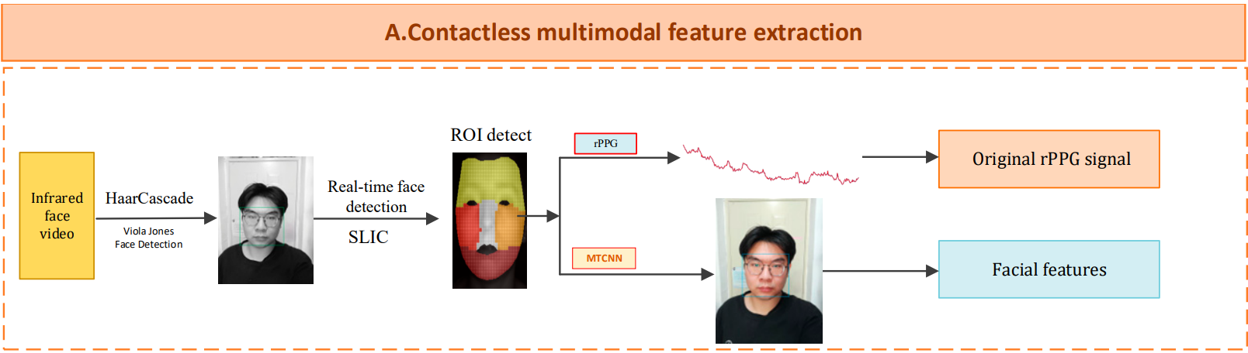
System Architecture
Haar-Cascade face detector to identify faces in all frames of the video stream
SLIC algorithm for superpixel skin segmentation on the detected face areas
Source: L. Kong, K. Xie, K. Niu, J. He, and W. Zhang, “Remote Photoplethysmography and Motion Tracking Convolutional Neural Network with Bidirectional Long Short-Term Memory: Non-Invasive Fatigue Detection Method Based on Multi-Modal Fusion,” Sensors, vol. 24, no. 2, p. 455, Jan. 2024, doi: https://doi.org/10.3390/s24020455.
‌

Slide 4
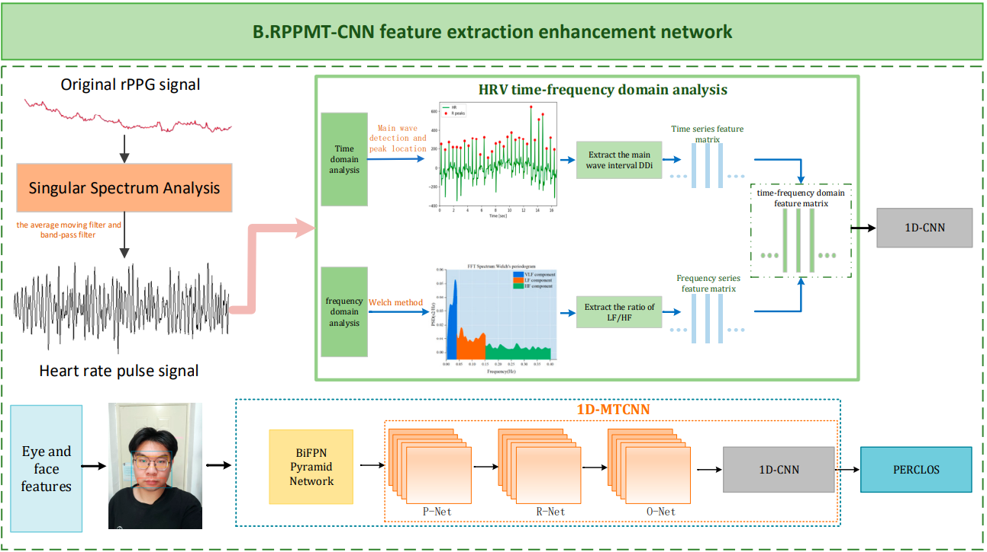
Source: L. Kong, K. Xie, K. Niu, J. He, and W. Zhang, “Remote Photoplethysmography and Motion Tracking Convolutional Neural Network with Bidirectional Long Short-Term Memory: Non-Invasive Fatigue Detection Method Based on Multi-Modal Fusion,” Sensors, vol. 24, no. 2, p. 455, Jan. 2024, doi: https://doi.org/10.3390/s24020455.
‌

Slide 5
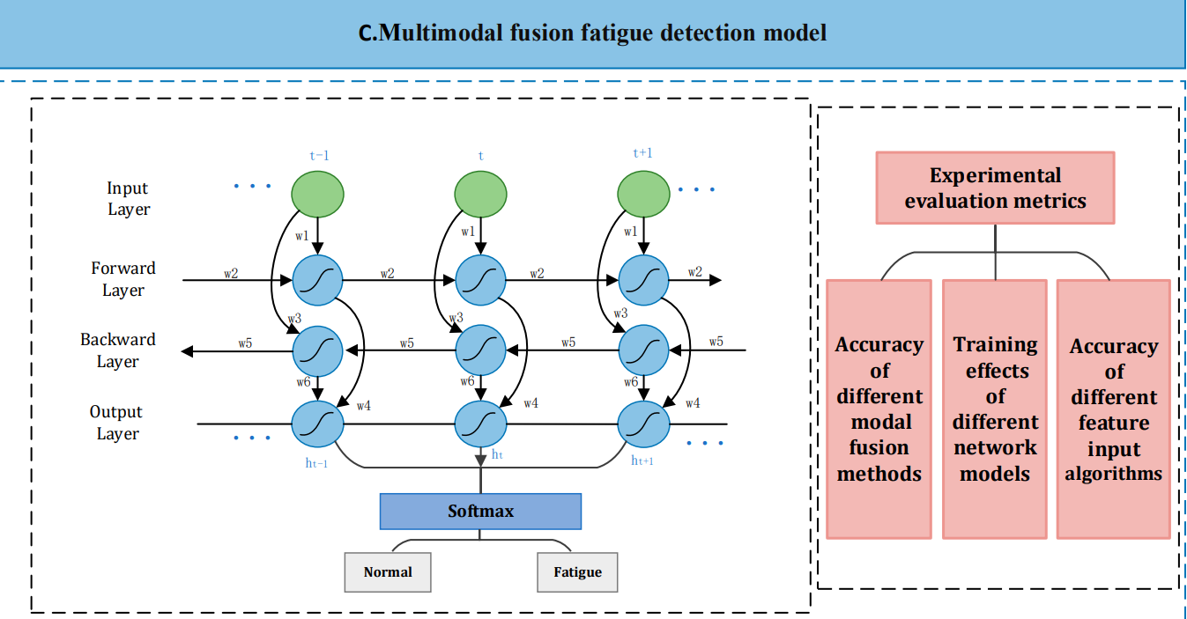
Source: L. Kong, K. Xie, K. Niu, J. He, and W. Zhang, “Remote Photoplethysmography and Motion Tracking Convolutional Neural Network with Bidirectional Long Short-Term Memory: Non-Invasive Fatigue Detection Method Based on Multi-Modal Fusion,” Sensors, vol. 24, no. 2, p. 455, Jan. 2024, doi: https://doi.org/10.3390/s24020455.
‌

Slide 6
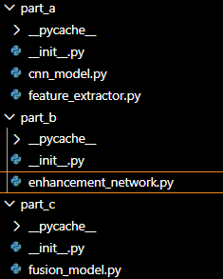
Part A
  cnn_model (for eye tracking)
  Feature_extractor
    Rppg extraction (this weeks progress)
    Eye drowsiness test (need training)
Part B
  Enhancement_network
Part C
  Fusion_model

Slide 7

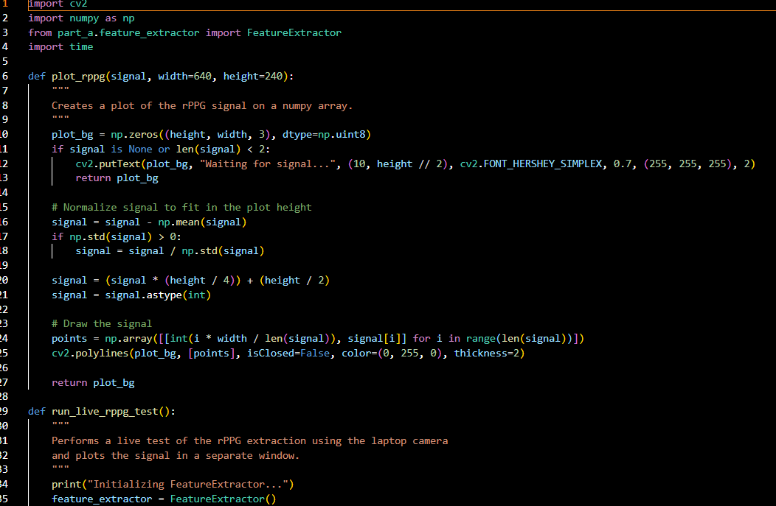
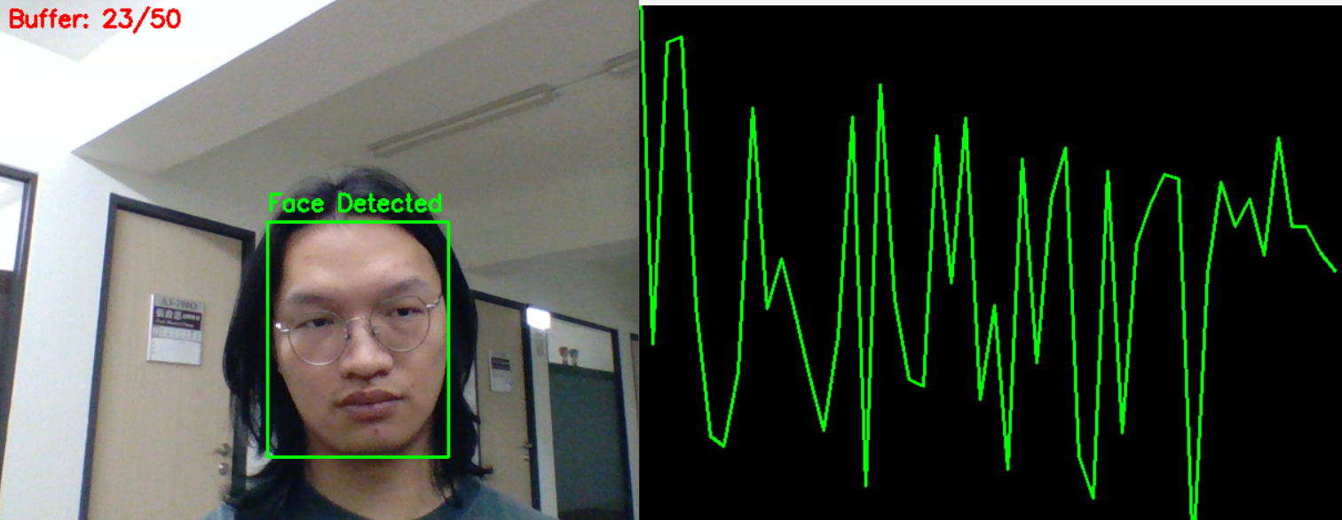
For rppg extraction I mainly uses Chrom rPPG. I had created a test program and run.

Slide 8
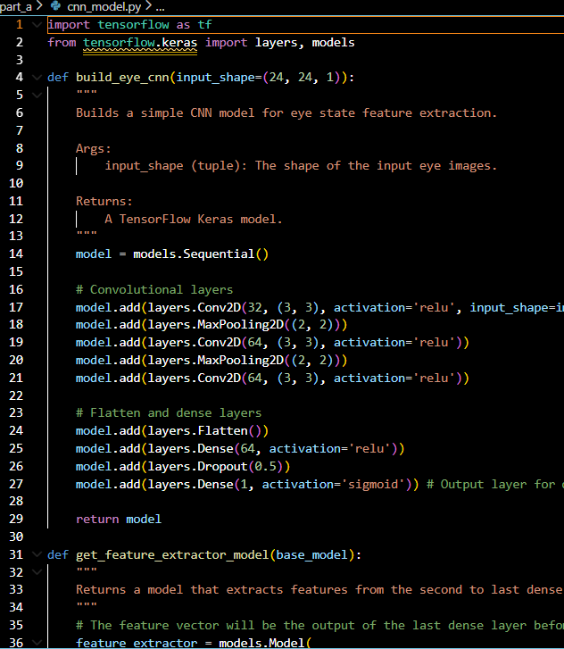
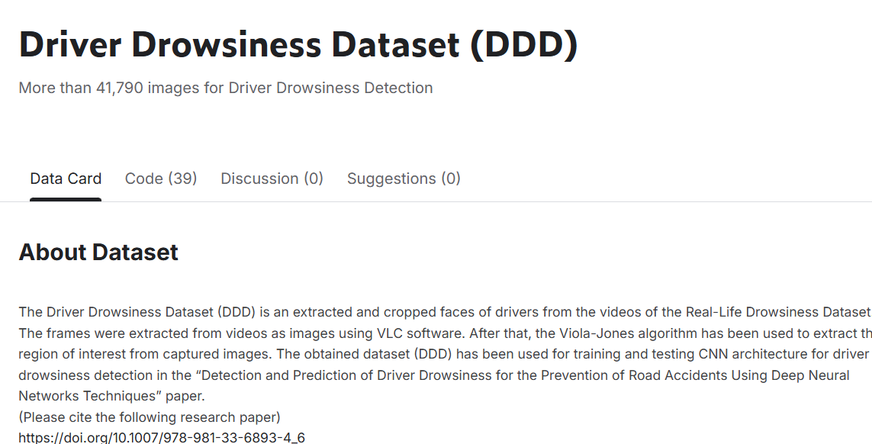

Slide 9
Thank you for listening
Q&A session

